Slide 1

Risk Factors for Anxiety in Older Adults
STAT 228 Final Project
Team Gen4gen
Anna Lieb, Caroline Jung, and Hannah Chiou
Notes:
Hannah

Slide 2
Outline
Motivation & Research Question
Data Cleaning & Variable Selection
Model Fit & Model Comparison
Conclusion & Future Work
Notes:
Hannah

Slide 3
About the Dataset
Aggregated Virtual Patient Model Dataset, 2019
Contains medical information about older people (ages 70-85)
Metrics include:
Levels of strength, physical fitness, physical activity
Medical incidents
Social interaction
Perceptive & cognitive ability
Dimensions: 117 rows x 59 columns
30 patients with 4 visits each, total of 117 medical check-ups over time
Dataset posted by Konstantinos Deltouzos (available on Zenodo)
Data collected by: John Ellul; Marina Polycarpou; Marina Kotsani, Evangelia I. Zacharaki
Notes:
Hannah
mental health info

Slide 4

Motivation
Why anxiety? And why the older population?
Our interest in medical data and mental health
Anxiety disorders affect 10-20% of older adults
Anxiety disorders often go undiagnosed
Patients don’t recognize symptoms
Patients are often suffering from other medical conditions
Untreated anxiety can lead to cognitive impairment, poor physical health, poor quality of life
Goal: to understand the predictors that indicate if an older adult is at risk of anxiety
American Association for Geriatric Psychiatry, https://www.aagponline.org/patient-article/anxiety-and-older-adults-overcoming-worry-and-fear/
Notes:
Caroline

Slide 5



Research Question
Which medical and lifestyle factors are most important for predicting anxiety among older adults?
Notes:
Caroline

Slide 6
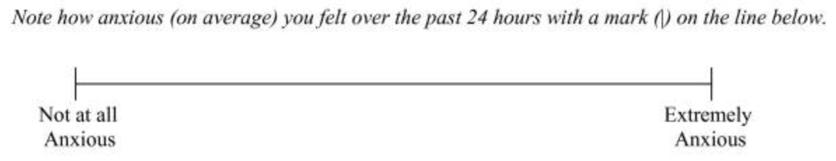
Measuring Anxiety
Self-perceived anxiety (not a diagnosis)
Anxiety auto-evaluation: visual analogue scale from 0-10
Williams et al., https://www.ncbi.nlm.nih.gov/pmc/articles/PMC2904728/
Notes:
Caroline

Slide 7
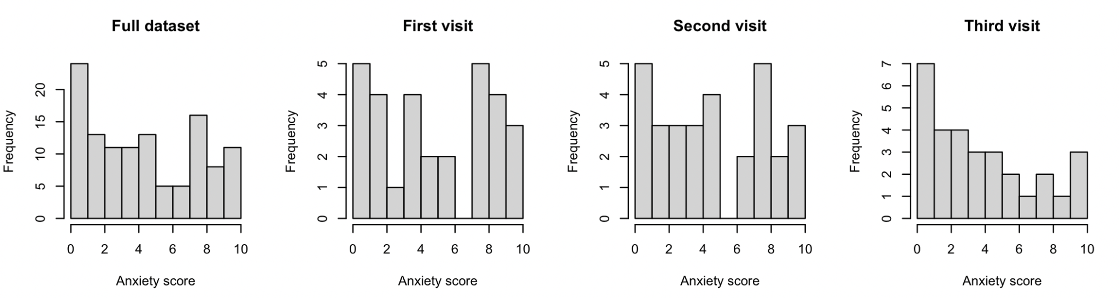
Data Cleaning
Step 1: Choose subset of data for a single visit (out of 4)
Visit 2 & 4: missingness
Visit 3: had the least missingness out of visits 1-3, and anxiety score distribution was not very different from full dataset
Notes:
Anna
Bc time series data

Slide 8
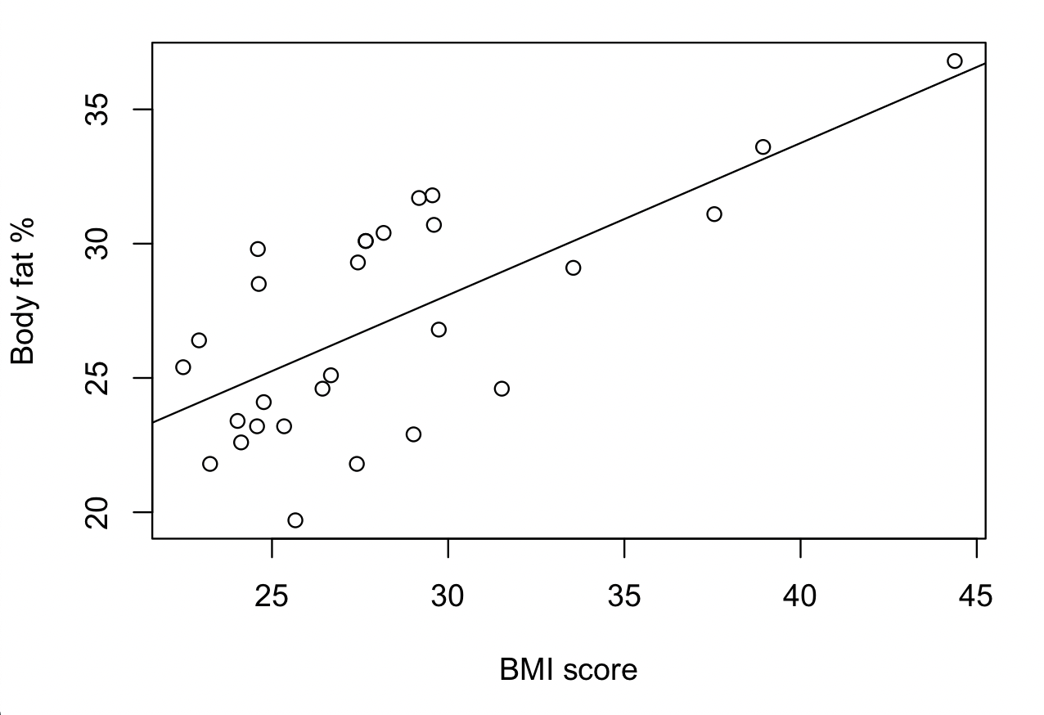
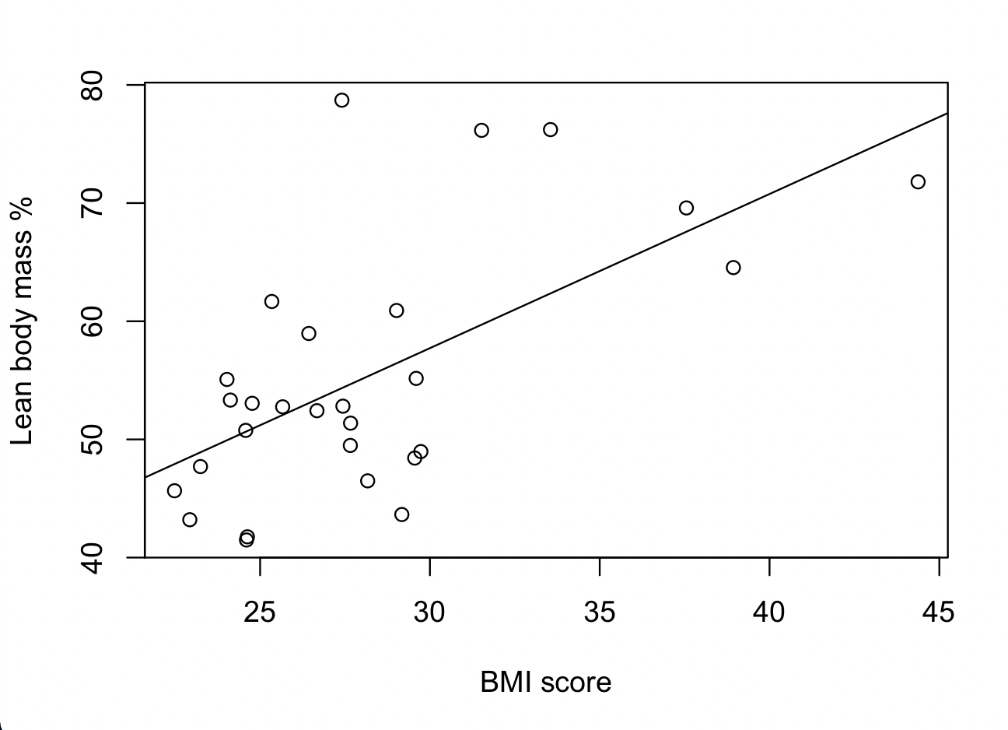
Data Cleaning
Step 2: Imputation
Non-missing values from other visits
Using single linear regression (with bmi_score)
bmi_body_fat, lean_body_mass
Mean imputation
Removed 3 columns with all NAs
Step 3: Avoid overfitting (comorbidities_most_important)
3 levels: None of the above (26), osteoporosis (1), and prior stroke (3)
Recode to be:
“Yes” if listed any comorbidities
“No” if none of the above
Notes:
Anna
Visit 4 for bmi body fat and lean body mass (this number would relatively be similar from trial to trial)
Visit 1 for stairs numbers (makes sense bc this number wouldn’t change from trial to trial)

Slide 9
Variable Selection via Lasso Regression
Goal: reduce number of predictors (originally 58)
Why lasso?
Possible presence of multicollinearity among variables (could be present in predictors such as BMI score, body fat %, waist)
More predictors than observations
Can perform both variable selection and parameter estimation at once
Steps:
Find best lambda (tuning parameter) that provided best balance between bias and variance
Found coefficients of the variables in the regression model
Tested for possible multicollinearity using VIF screening
no predictors were found to be collinear
Notes:
Hannah
Even with outliers — assumptions still hold. Also small sample size.

Slide 10
Variable Selection via Lasso Regression
9 variables were selected via lasso regression → used by all further analysis
Predictors with non-zero coefficients:
s1
(Intercept) 39.1029876651
age -0.1679481971
comorbidities_most_important 0.4323228150
screening_score -1.6906640541
depression_total_score 0.2332328684
social_visits -0.0299951576
social_phone 0.0004674094
health_rate -0.0646271050
comorbidities_count 0.0144137518
medication_count 0.0680667500
Notes:
Hannah

Slide 11
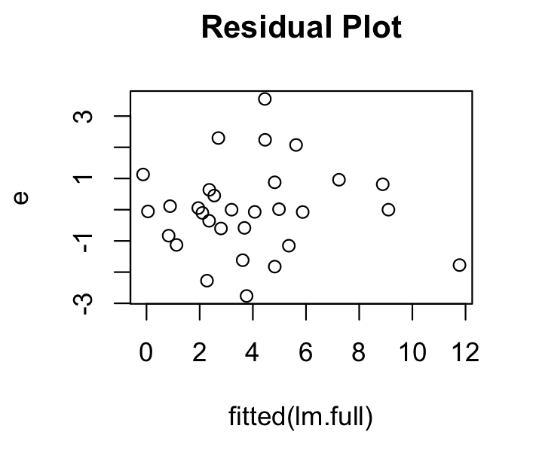
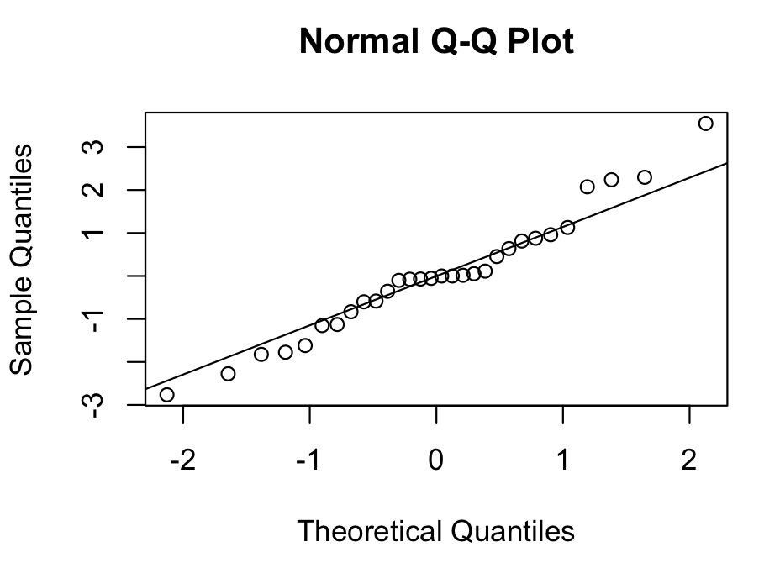
Assumptions
Mean 0 ✓
Constant variance ✓
3. Normality ✓
Notes:
Caroline

Slide 12
Stepwise Regression
Objective: Use stepwise regression to examine the statistical significance of each of the predictors chosen by lasso regression and find potential best model. Test both AIC and BIC as methods of model fit that are penalized for number of parameters.
AIC Model:
anxiety_perception ~ age + comorbidities_most_important + screening_score + depression_total_score + health_rate
BIC Model:
anxiety_perception ~ age + screening_score + social_phone + comorbidities_count
Notes:
Hannah

Slide 13
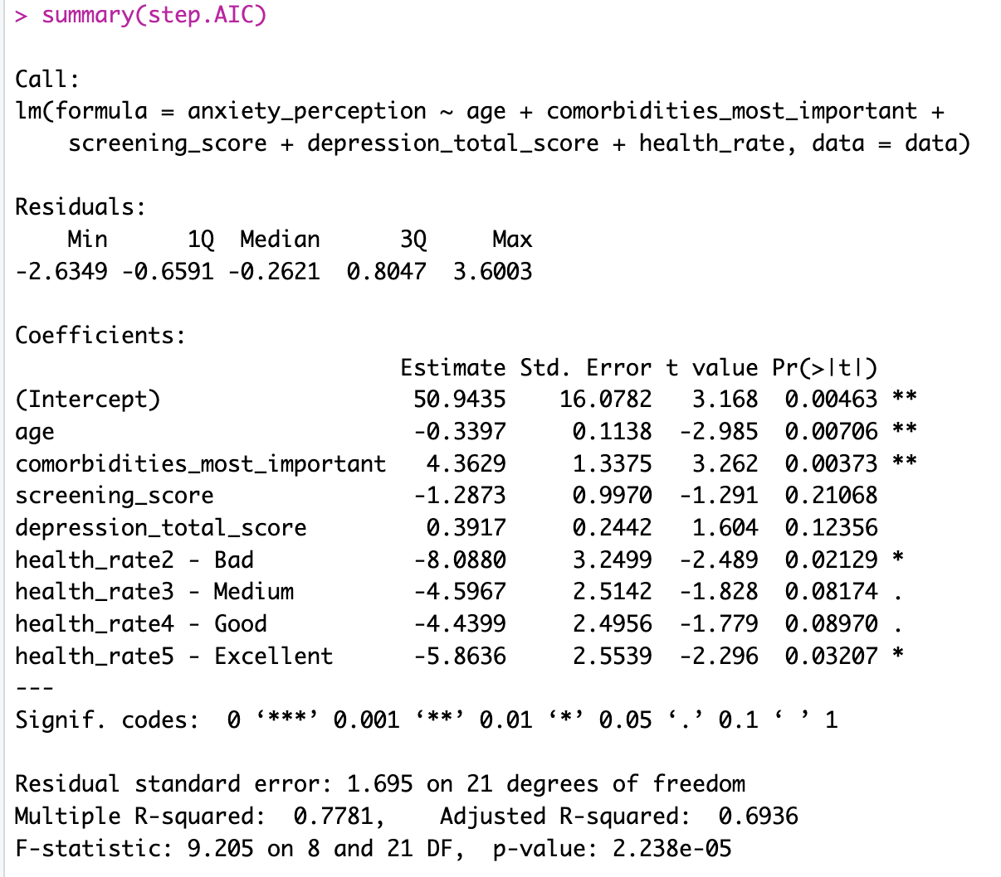
Stepwise AIC model
Higher anxiety scores related to:
Lower age
Presence of important comorbidity
Lower screening score (on Mini Nutritional Assessment)
Higher depression score
Lower self-rated health rate
Notes:
Hannah
Important predictors (based on the sign of the coefficients. Some more significant than others):
age
comorbidities_most_important: 1 if a person has a significant comorbidity that affects their daily life (prior stroke, osteoporosis), 0 if none
screening_score: Mini Nutritional Assessment (MNA) screening score
12-14 points: Normal nutritional status
8-11 points: At risk of malnutrition
0-7 points: Malnourished
depression_total_score: 15-item Geriatric Depression Scale (GDS-15)
Used for older population
Score > 5 suggests depression, should warrant follow-up comprehensive assessment
Score ≥ 10 almost always indicative of depression
health_rate: self rated qualitative and ordinal health status
CV score: 14.91841
Negative coefficient for age suggests that older adults have lower self percieved anxiety
Relatively large coefficient for comorbidities — having significant, daily life altering comorbidity increases anxiety which makes sense, have more concerns about health
Screening score — higher screening score = GOOD so having higher screening score means lower anxiety
Depression total score — makes sense that more depressed individuals / higher socres would have more anxiety, presence of multiple mental health issues
Higher health rate means lower anxiety

Slide 14
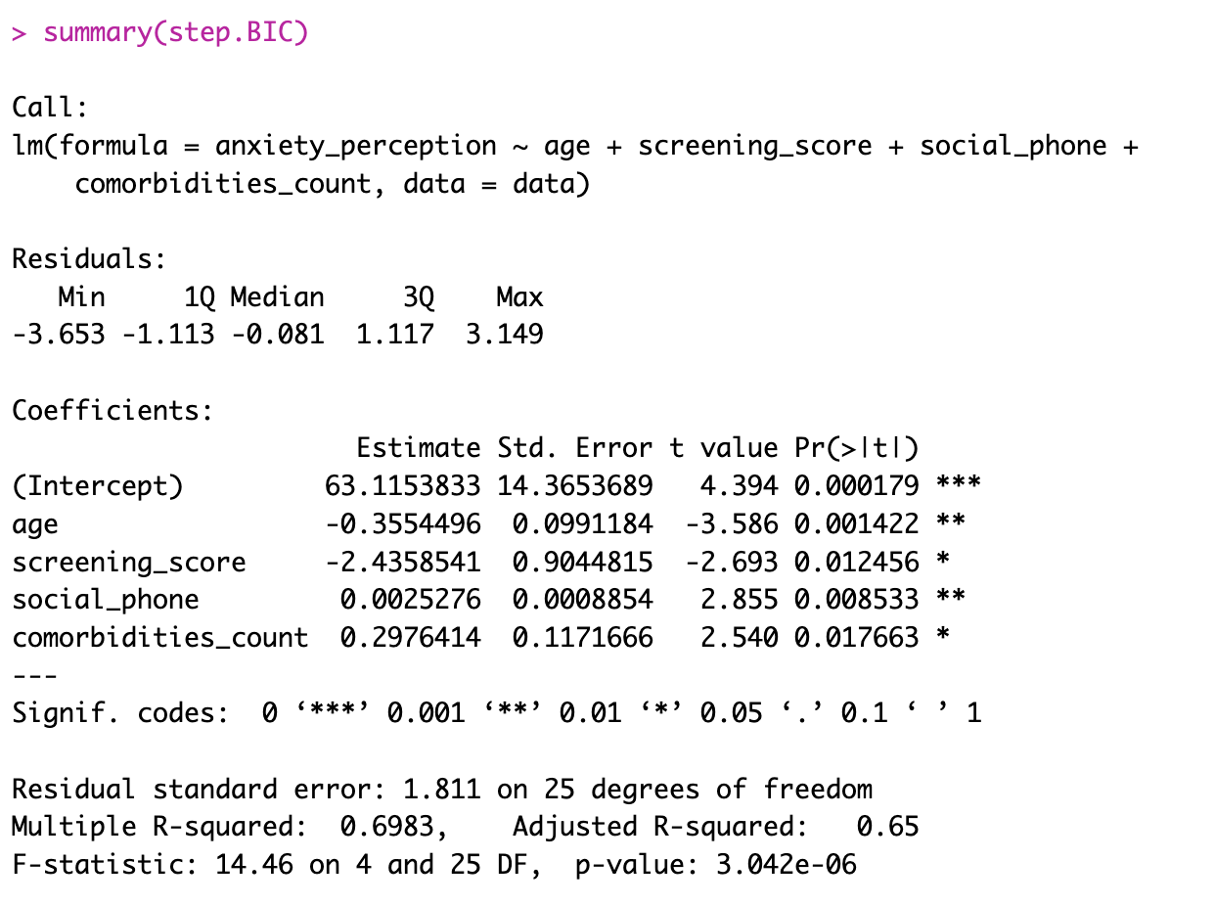
Stepwise BIC model
Higher anxiety scores related to:
Lower age
Lower screening score (on Mini Nutritional Assessment)
More time spent on phone
More comorbidities
Notes:
Hannah
Important predictors:
comorbidities_count: number of comorbidities
Disease/medical condition that is simultaneously present with another
age
social_phone: approximate time spent on phone per week
Different from social_calls
screening_score: Mini Nutritional Assessment (MNA) screening score
CV score: 6.976845
Age, again see negative correlation
Screening score, again see negative correlation
Comorbidities count — each comorbidity increases anxiety (for older adults: heart disease, hypertension/high blood pressure, diabetes, respiratory problems, mental health, etc)
Social phone — how much time spent on phone, positive so more time spent looking at phone etc (isolation) = more anxious

Slide 15
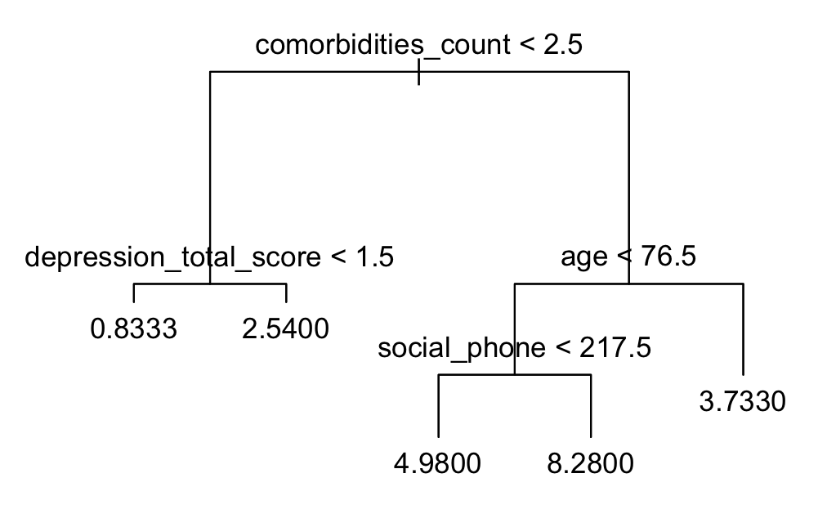
Regression Tree
Higher anxiety scores related to:
More comorbidities
More time spent on phone
Higher depression
Younger age
Full and pruned tree have 5 terminal nodes
Notes:
Caroline

Slide 16
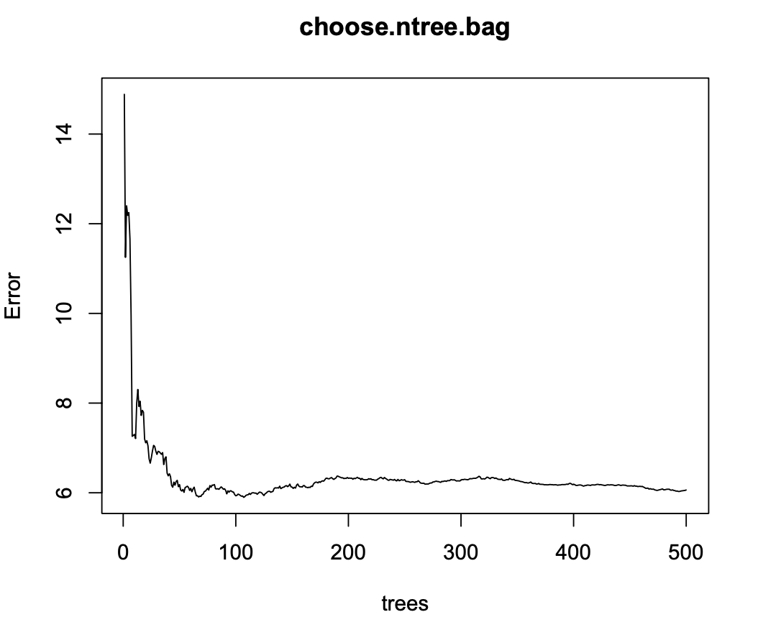
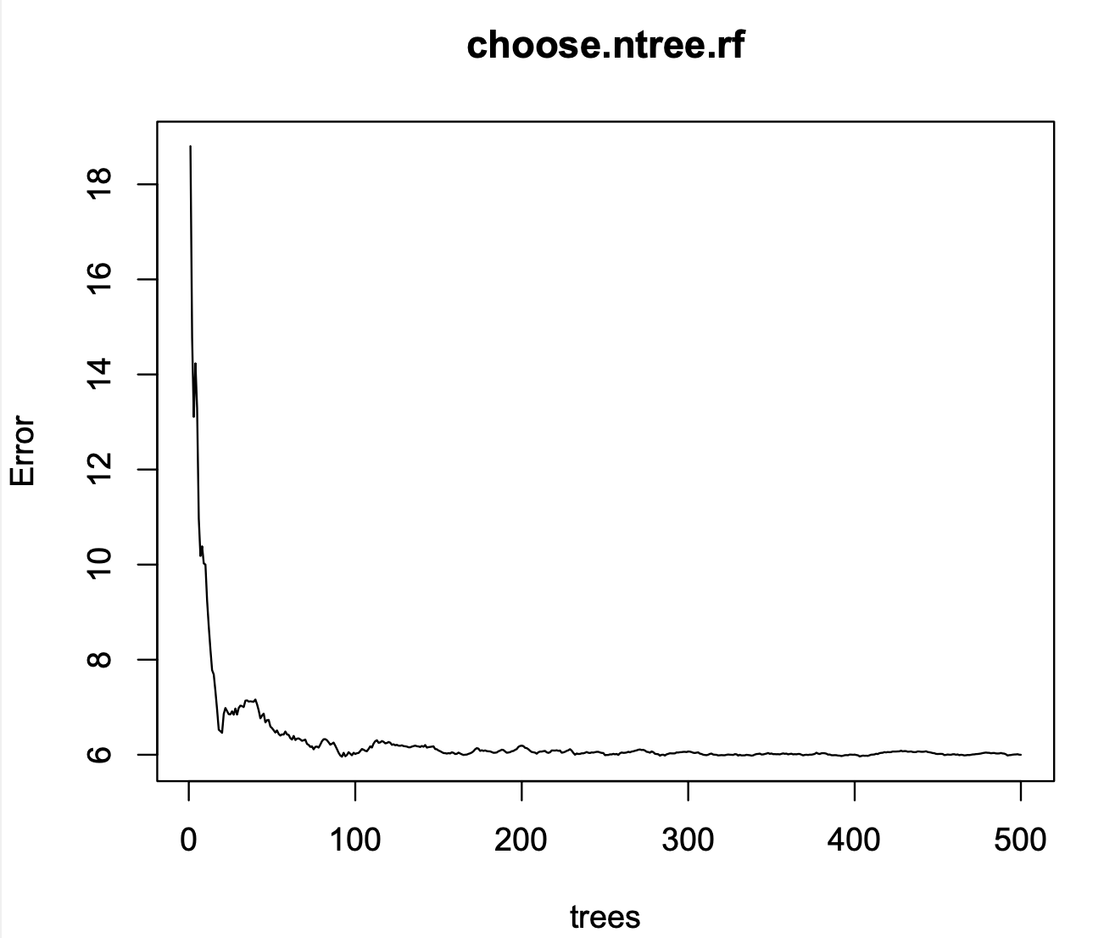
Tree-based Ensemble Methods
1. Bagging (with ntree=100)
2. Random forest (with ntree=100)
Notes:
Anna
Stabilizes at 100

Slide 17
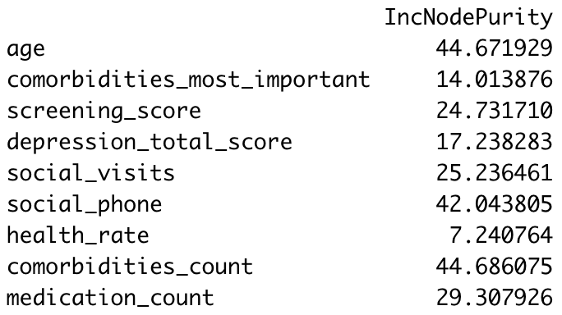
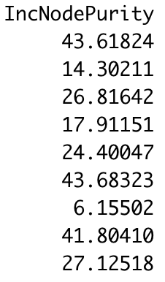
Ensemble Method Importance Plots
Bagging Random Forest
IncNodePurity: the average decrease in node heterogeneity from splitting on the variable
For regression, it is measured by residual sum of squares.
Higher IncNodePurity → More decrease in RSS from splitting on the variable → more homogeneous nodes → that variable is more important for predicting anxiety level
Top 3 most important:
Age
Number of comorbidities
Time spent on phone
Notes:
Total decrease in node impurities from splitting on the variable, averaged over all trees
If it is split on the variable, then can calculate decrease in node impurities
If we have larger decrease, then that means that the variable is important to not decrease that much
Node is impure if we have some nodes split on yes and no?
Node is pure if all yes or all no
The higher the number, the more decrease in node impurities from splitting on the variable ⇒ less nodes are impure ⇒ more nodes are pure ⇒ that variable is more important?
Measured by residual sum of squares
https://www.stat.cmu.edu/summer/cmsacamp/Week_04_Tuesday/RF_Var_Imp.Rmd

Slide 18
Model Comparison
Model | CV score (avg squared error) | Avg Error
Stepwise Regression | AIC: 14.92 BIC: 6.98 | AIC: 3.86 BIC: 2.64
Regression Tree | 12.55 | 3.54
Ensemble methods | Bagging: 6.13 Random forest: 6.28 | Bagging: 2.48 Random forest: 2.51
Interpretation
anxiety_perception scores are calculated on a 10-point scale
Ensemble methods gives us the best prediction with an avg error of ~2.5
Notes:
Anna

Slide 19
Conclusion
Ensemble methods: lowest CV score
BIC model, regression tree, and ensemble methods relies on similar predictors:
Appears in all three
comorbidities_count: Number of comorbidities
age
social_phone: Approximate time spent on phone per week
Appears in two of these models
screening_score: Mini Nutritional Assessment (MNA) screening score
depression_total_score: 15-item Geriatric Depression Scale (GDS-15)
Higher levels of anxiety are associated with more time spent on phones, more comorbidities, younger age, malnourishment, and higher levels of depression
Notes:
Caroline

Slide 20

Limitations & Future Work
Couldn’t account for temporal relationships in time series data, had to choose one trial
Try longitudinal analysis
The dataset is very small and only included 30 observations ⇒ our results might not be generalizable
Could be helpful to work with a larger dataset
Notes:
Hannah
https://www.tableau.com/learn/articles/time-series-analysis

Slide 21
References
Zenodo, 2019. “Aggregated Virtual Patient Model Dataset” (https://zenodo.org/record/2670048#.ZE7B7-zMIbm)
American Association for Geriatric Psychiatry, 2022. “Anxiety and Older Adults: Overcoming Worry and Fear” (https://www.aagponline.org/patient-article/anxiety-and-older-adults-overcoming-worry-and-fear/)
The Geriatric Depression Scale (GDS), 2012. (https://wwwoundcare.ca/Uploads/ContentDocuments/Geriatric%20Depression%20Scale.pdf)
Williams, Morlock, and Feltner, 2010. “Psychometric evaluation of a visual analog scale for the assessment of anxiety” (https://www.ncbi.nlm.nih.gov/pmc/articles/PMC2904728/)

